Slide 1
Shuttle:
Current State and Next Generations
Presented by Kao, Chen-yi

Slide 2


Outline
Current Shuttle
  Motivation
  Related research
  Concept synchronization
  Linking model elements and concepts
  Text boundary detection
  GMF integration
Short-term plan (within a year)
Long-term plan

Slide 3
Current Shuttle
An Instant Model Synchronization Assistant for GMF Editors Based on Concept Synchronization
Motivation: modern model synchronization still needs...
  Instant (better automatic and intuitive) round-trip engineering anytime everywhere
    NOT ONLY in synchronizing GUI/Java or UML/Java, etc., but generally ALL kinds of models
  Refactoring beyond exact string matching
    E.g. renaming variable – in variable name and comment there may be different occurrences of the equivalent term.

Slide 4
Related research
Graph/Model Transformation
  AGG, CODEX, UMLX, ATL, etc.
  Another (transformation) language to learn
  Did not automatically transform graphs/models according to element text
    Treating element text as black box

Slide 5
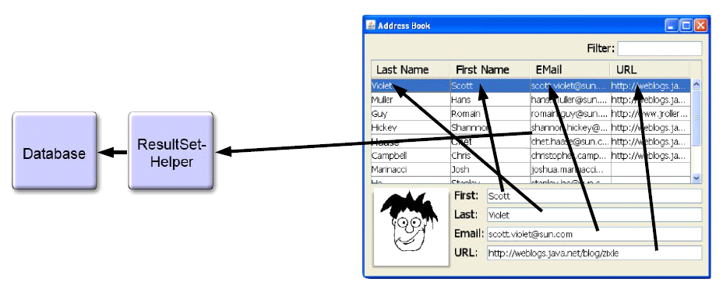
Related research (cont.)
Data Binding
  Beans Binding (JSR 295), JFace Data Binding

Slide 6
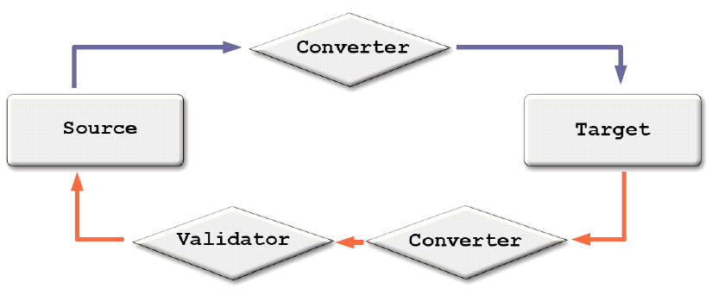
Data Binding (cont.)
Assign binding, then synchronization is automatic

Slide 7
Concept synchronization
Ontology
  …is often conceived as a set of classes (concepts), relations, functions, axioms and instances (Gruber, T.R., 1993)
Information Retrieval
  Concept search – beyond keyword search
  Concept – semantically related keywords

Slide 8
Concept synchronization (cont.)
WordNet

Slide 9
Concept synchronization (cont.)
By concept search, Web pages of the same concept can be found together, and how about model elements?
Shuttle: Concept based on WordNet Synset

Slide 10
Linking model elements and concepts
MIT Java WordNet Interface (JWI)
From String to Synset
  1. WordNet Dictionary Lookup
    edu.mit.jwi.dict.IDictionary
      IIndexWord getIndexWord(java.lang.String lemma, PartOfSpeech pos);
  2.1 Concept Search - Basic Concept Search
    edu.mit.jwi.item.IIndexWord
      IWordID[] getWordIDs();
    edu.mit.jwi.item.IWordID
      ISynsetID getSynsetID();

Slide 11

From String to Synset (cont.)
2.2. Extended Concept Search
  edu.mit.jwi.item.IWord
    IWordID[] getRelatedWords();
      Words in other part-of-speeches (POS, one of NOUN, VERB, ADJECTIVE and ADVERB)
    And like Basic Concept Search
  edu.mit.jwi.item.ISynset
    ISynsetID[] getRelatedSynsets();
      Hypernym（泛義／上位詞）, Hyponym（特義／下位詞）, Meronym（成分詞）, Holonym（合成詞）,… Synsets under the same POS
To resolve Isynset from ISynsetID:
  ISynset edu.mit.jwi.dict.IDictionary.getSynset(ISynsetID)

Slide 12
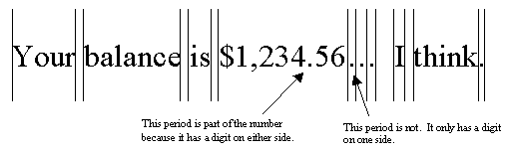
Text boundary detection
java.text.BreakIterator
  Sentence boundary analysis
    BreakIterator BreakIterator.getSentenceInstance()
    void BreakIterator.setText(String newText)
    int BreakIterator.next()
    String String.substring(int beginIndex, int endIndex)
  Word boundary analysis
    BreakIterator BreakIterator.getWordInstance()
    …

Slide 13
Text boundary detection (cont.)
To handle compound words with CamelCase/underscore
  We design CompoundWordBreakIterator
    Sub-classing BreakIterator

Slide 14
When model element text is modified…

Slide 15
GMF integration
GMF Labels…

Slide 16
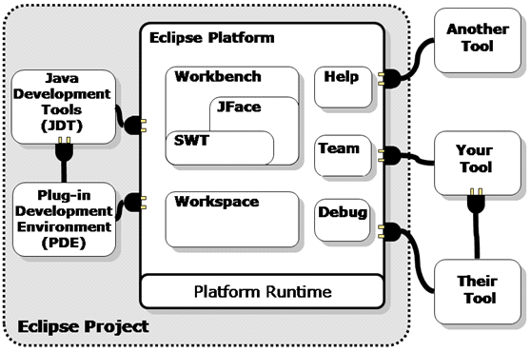

GMF integration (cont.)
Eclipse Plug-ins and Extension Points
  GMF: plug-in of Eclipse; Shuttle: plug-in of GMF

Slide 17
Outline
Current Shuttle
Short-term plan (within a year)
  Related works
  Client-side
    (Structural) rule inference result recommendation (RIRR) visualization
  Server-side
    Light-weight rule-base
Long-term plan

Slide 18
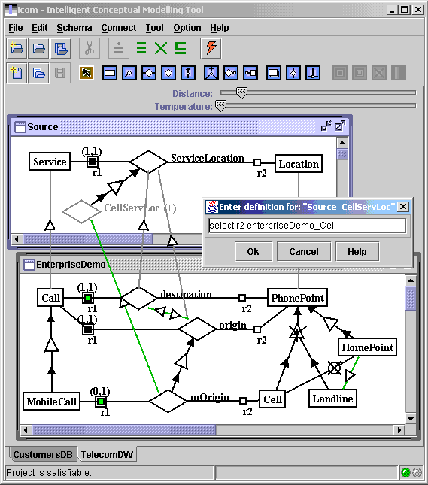
Related works
LaSSIE (Devanbu et al., 1991)
  Low "semantic noise" but Manually connecting domain and code models
ICOM (http://www.inf.unibz.it/~franconi/icom/)
  Complete logical reasoning to verify the specification, infer implicit facts, devise stricter constraints, and manifest any inconsistency.

Slide 19
Client-side: RIRR visualization
Reduce semantic noise
Extended from concept linking...
  OWL ontology linking
  SWRL rule triggering
    hasParent(?x1,?x2) ∧ hasBrother(?x2,?x3) ⇒ hasUncle(?x1,?x3)
  SWRL rule inference
    Direct inference
    Indirect inference by KAON2(http://kaon2.semanticweb.org/) reasoner
  RIRR visualization
    Case by case...

Slide 20
Link Models and Ontologies

Slide 21
SWRL rule consequent may be...
atom ::= description '(' i-object ')'
| dataRange '(' d-object ')'
| individualvaluedPropertyID '(' i-object i-object ')'
| datavaluedPropertyID '(' i-object d-object ')'
| sameAs '(' i-object i-object ')'
| differentFrom '(' i-object i-object ')'
| builtIn '(' builtinID { d-object } ')'

Slide 22
Server-side: light-weight rule-base
For rule persistence and reuse
Based on Protégé (http://protege.stanford.edu/)
Indexed by concept to accelerate ontology linking

Slide 23
Outline
Current Shuttle
Short-term plan (within a year)
Long-term plan

Slide 24
Long-term plan
Handling acronym and custom concepts
Handling multi-lingual models/ontology
Handling non-textual (structural) model elements
Using model-ontology linkage in program rediscovery / mining
Integrate design patterns and aspects, etc. into software rules
Integrate the inference in program/document validation

